Slide 1

NBA Statistical Analysis
A statistical analysis on NBA professional basketball players driven by machine learning techniques to find and identify under and over performers

Slide 2
Agenda
Main Research Questions
Current Results
Data Set Used
Future Steps
Process Decided On
Questions

Slide 3
Main Research Questions
What drives player efficiency?
Are certain playstyles more efficient than others?
What makes a player good? How can we identify them?
Is there a way to identify underperforming players?
Is there a way to identify overperforming players?

Slide 4

Data Overview
The data used in this analysis is the player data from the 2024-2025 NBA Season. It includes a mixture of a players box stats and advanced stats across the season
All data is publicly available and pulled from basketball-reference.com . Additionally it is subset to players who have at least 5 minutes played per game

Slide 5
Box Stats
Player: the players name
Age: the players age in years
Team: the team that player played for
Pos: player's position
G: How many games that player played for that team in the 2024-2025 season
GS: How many games that player started for that team in the 2024-2025 season
MP: Average minutes per game that player played (both the box score stats and the advanced stats had minutes per game so it's duplicated in MP_x and MP_y)
FG: Average number of field goals that player made per game in the 2024-2025 season
FGA: Average number of field goals that player attempted per game in the 2024-2025 season
FG%: percentage of field goals made for that player in the 2024-2025 season
3P: average number of three pointers that player made per game in the 2024-2025 season
3PA: average number of three pointers attempted by that player per game in the 2024-2025 season
3P%: percentage of three pointers made by that player in the 2024-2025 season
2P: average number of two pointers made per game by that player in the 2024-2025 season
2PA: average number of two pointers attempted by that player per game in the 2024-2025 season
2P%: percentage of two pointers made by that player in the 2024-2025 season
eFG%: That players effective field goal percentage for the 2024-2025 season

Slide 6
Box Stats - Continued
FT: average number of free throws made by that player per game for the 2024-2025 season
FTA: average number of free throws attempted by that player per game for the 2024-2025 season
FT%: percentage of made free throws for that player in the 2024-2025 season
ORB: average number of offensive rebounds per game for that player in the 2024-2025 season
DRB: average number of deffensive rebounds per game for that player in the 2024-2025 season
TRB: average number of total rebounds per game for that player in the 2024-2025 season
AST: average number of assists for that player per game for the 2024-2025 season
STL: average number of steals per game for that player in the 2024-2025 season
BLK: average number of blocks per game for that player in the 2024-2025 season
TOV: average number of turnovers per game for that player in the 2024-2025 season
PF: average number of personal fouls per game for that player in the 2024-2025 season
PTS: average number of points per game for that player in the 2024-2025 season

Slide 7
Advanced Stats
PER: that players Player Efficiency Rating for the 2024-2025 season
TS%: true shooting percentage, a percentage of made shots taking into account two pointers, three pointers and free throws
3PAr: three point attempt rate, percentage of shot attempts that were three pointers
FTr: free throw attempt rate, number of FT attempts per FG attempt
ORB%: offensive rebound percentage, percentage of possible offensive rebounds obtained by the player
DRB%: deffensive rebound percentage, percentage of possible deffensive rebounds obtained by the player
TRB%: total rebound percentage, percentage of total possible rebounds obtained by the player
AST%: assist percentage, estimate of the percentage of teammate field goals player assisted while on the floor
STL%: steal percentage, estimate of the percentage of opponent posession ended with a steal by the player while they were on the floor
BLK%: block percentage, estimate of the percentage of opponent 2 point attempts blocked by the player while they were on the floor
TOV%: turnover percentage, estimate of number of turnovers by player made in 100 possessions
USG%: usage percentage, estimate of percentage of team plays used by a player while on the floor
OWS: offensive win shares, estimate of number of wins a player contributed based purely on offense
DWS: deffensive win shares, estimate of number of wins a player contributed base purely on defense
WS: win shares, estimate of number of wins contributed by a player

Slide 8
Advanced Stats - Continued
WS/48: win shares per 48 minutes, estimate of number of wins contributed by a player in 48 minutes (league average is ~ 0.1)
OBPM: offensive box plus minus, box score estimate of offensive points per 100 possesions a player contributed above a league average player on an average team
DBPM: deffensive box plus minus, box score estimate of deffensive points per 100 possesions a player contributed above a league average player on an average team
BPM: box plus minus, box score estimate of total points per 100 possesions a player contributed above a league average player on an average team
VORP: value over replacement player, box score estimate of total points per 100 team possesions that a player contributed above a replace player on an average team

Slide 9

Analysis Process

Slide 10
Analysis Process
Step One: Find Correlated Variables
Step Two: Cluster On Playstyle
Step Three: Predict With Clustering
When running the analysis it is important that we don’t essentially recreate the formulas for PER and WS, so we needed to find correlated variables that aren’t directly included in the calculation of PER and WS.
Different play styles and player archetypes could have different effects on a players PER and WS. So in order to effectively determine if a player is an under performer or over performer, they should only be compared to players of a similar play style. So a kMeans clustering analysis is ran to determine how many different play style there are and to fit players into their playstyle.
Finally, in order to predict over performers and under performers, a linear regression (base line) and random forest regression model (more advanced) will be fit using the variables found in step one and the clusters found in step two trying to predict WS and PER.

Slide 11

Current Results

Slide 12
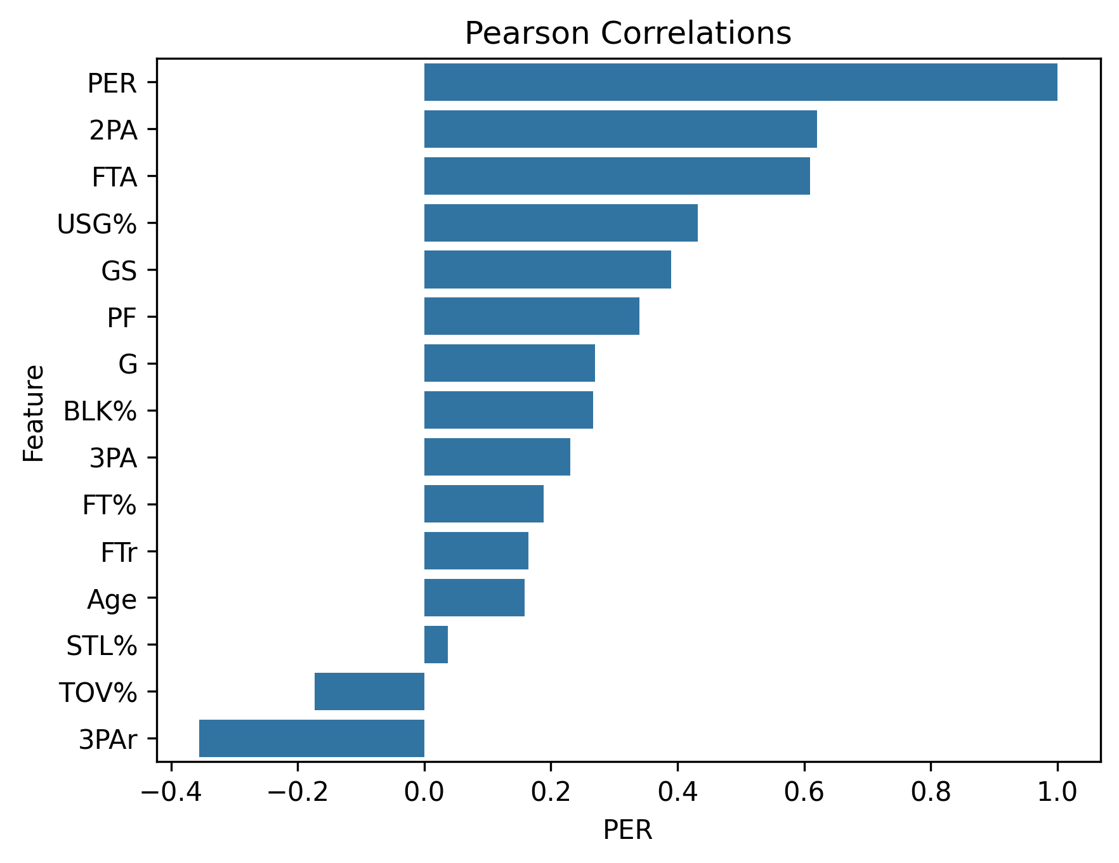
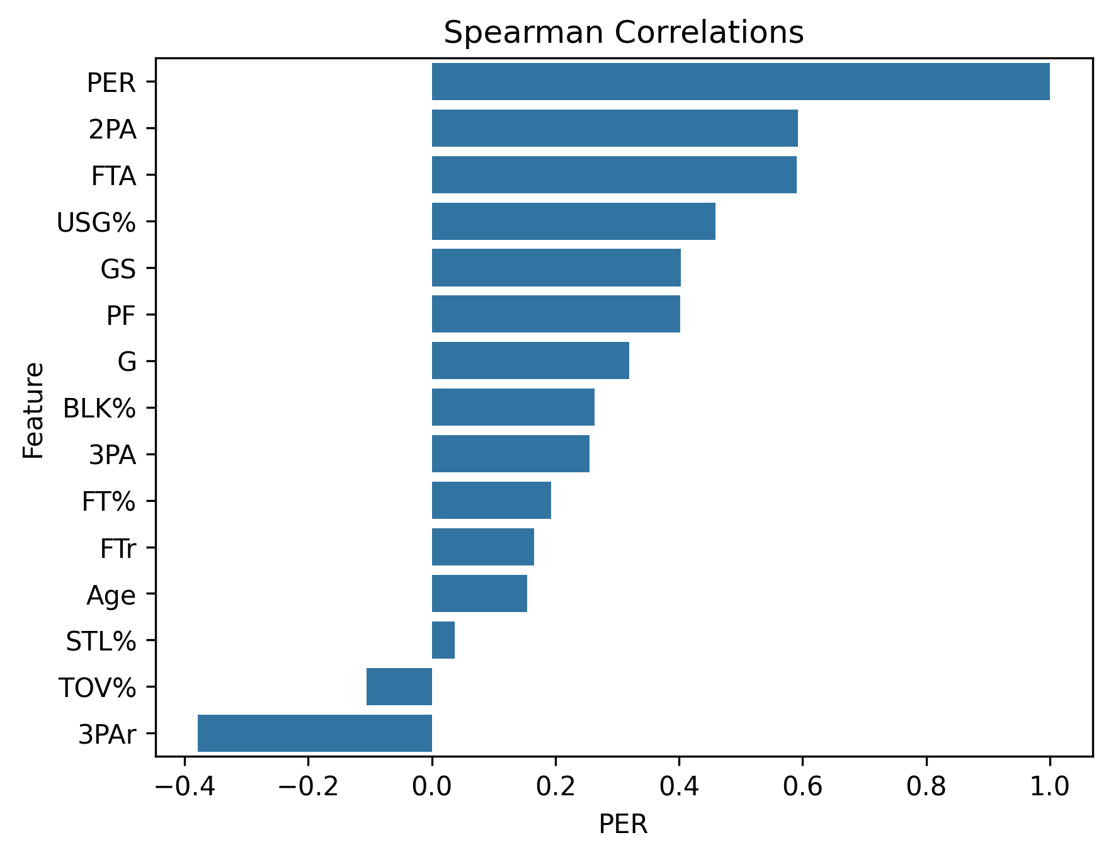
PER Correlation Analysis
Pearson Correlation
Spearman Correlation

Slide 13
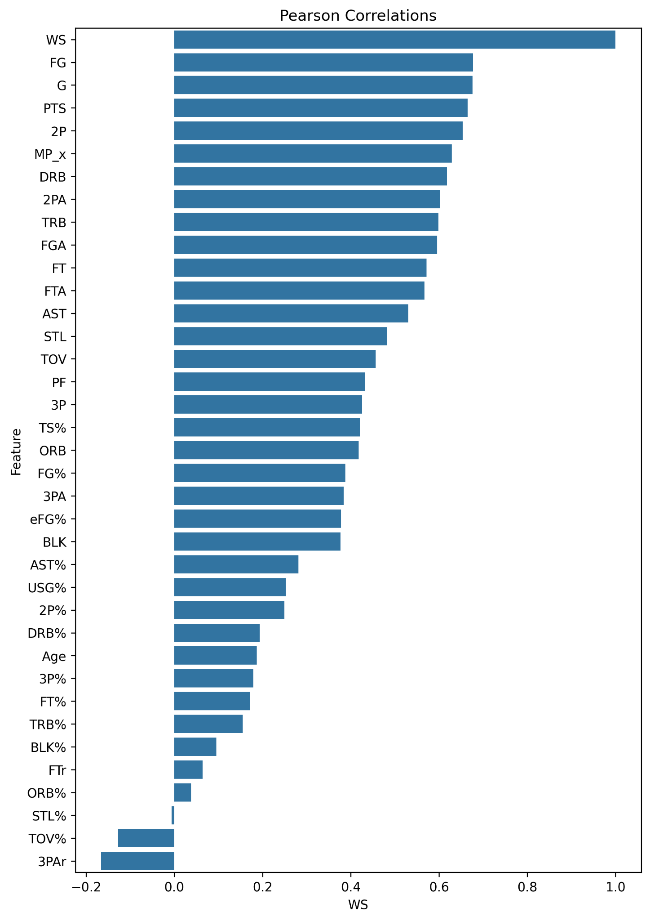
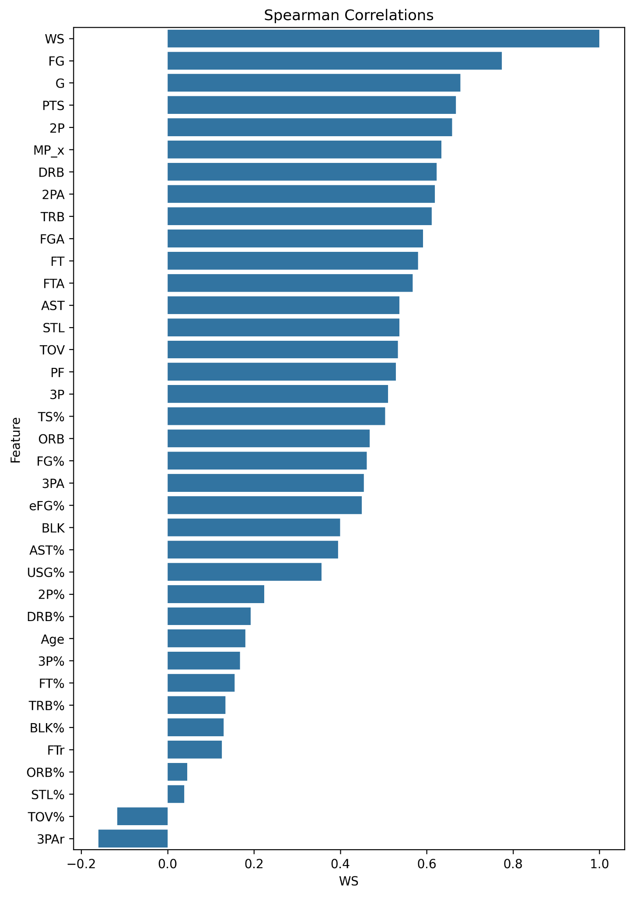
WS Correlation Analysis

Slide 14
Model Features
PER
WS
PER will be modeled by:
2PA
FTA
USG%
PF
3PA
TOV%
3PAr
Archetype Label
WS will be modeled by:
2PA
FTA
USG%
PF
3PA
TOV%
3PAr
Archetype Label

Slide 15

Clustering Results
Purpose:
Find player archetypes from the data
How does the player play when on the court?
We don’t care about efficiency
Features:
2PA per minute
3PA per minute
FTA per minute
PTS per minute
AST per minute
ORB per minute
DRB per minute
STL per minute
BLK per minute
3PAr
USG%
FTr

Slide 16
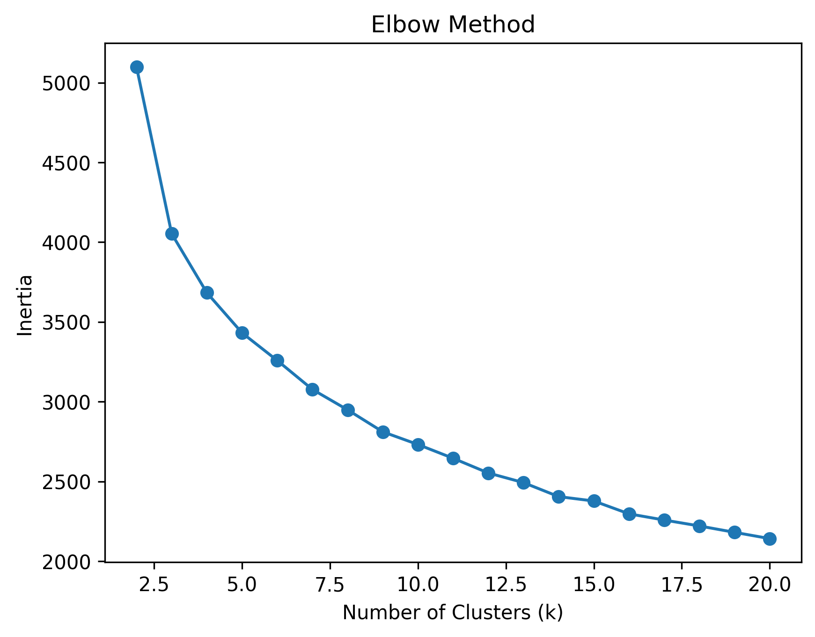
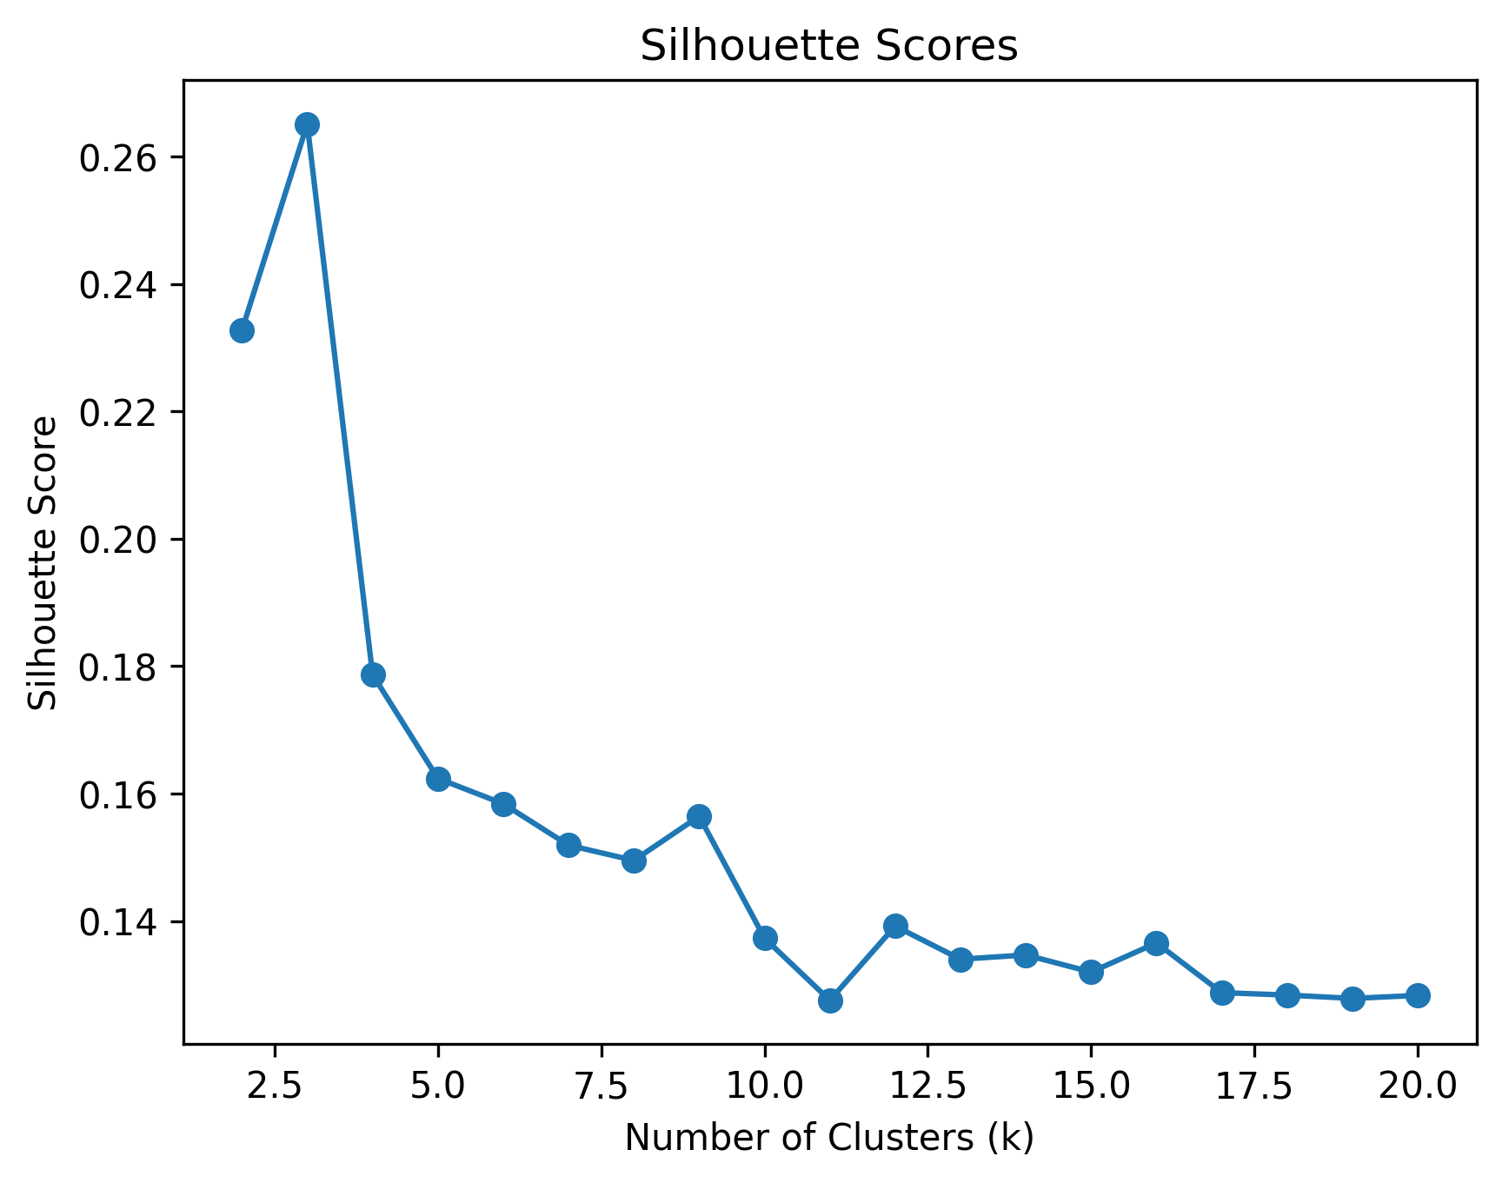
Clustering

Slide 17
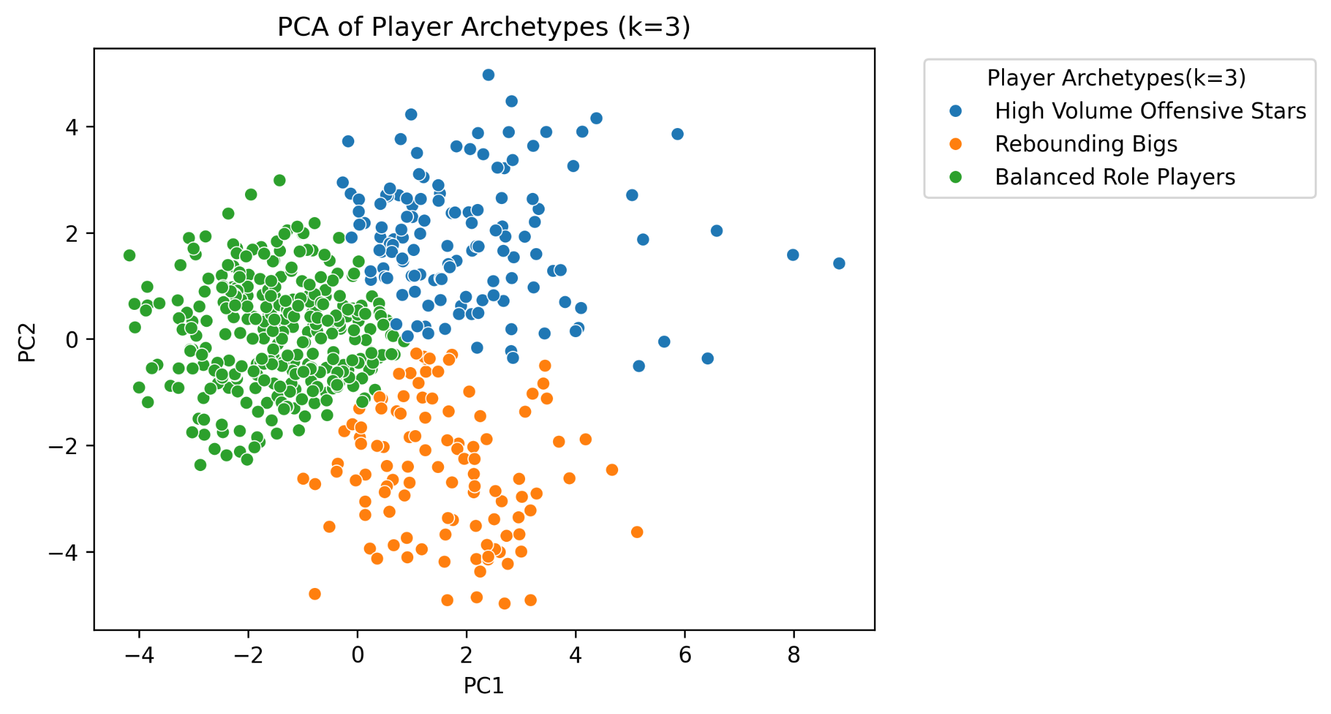
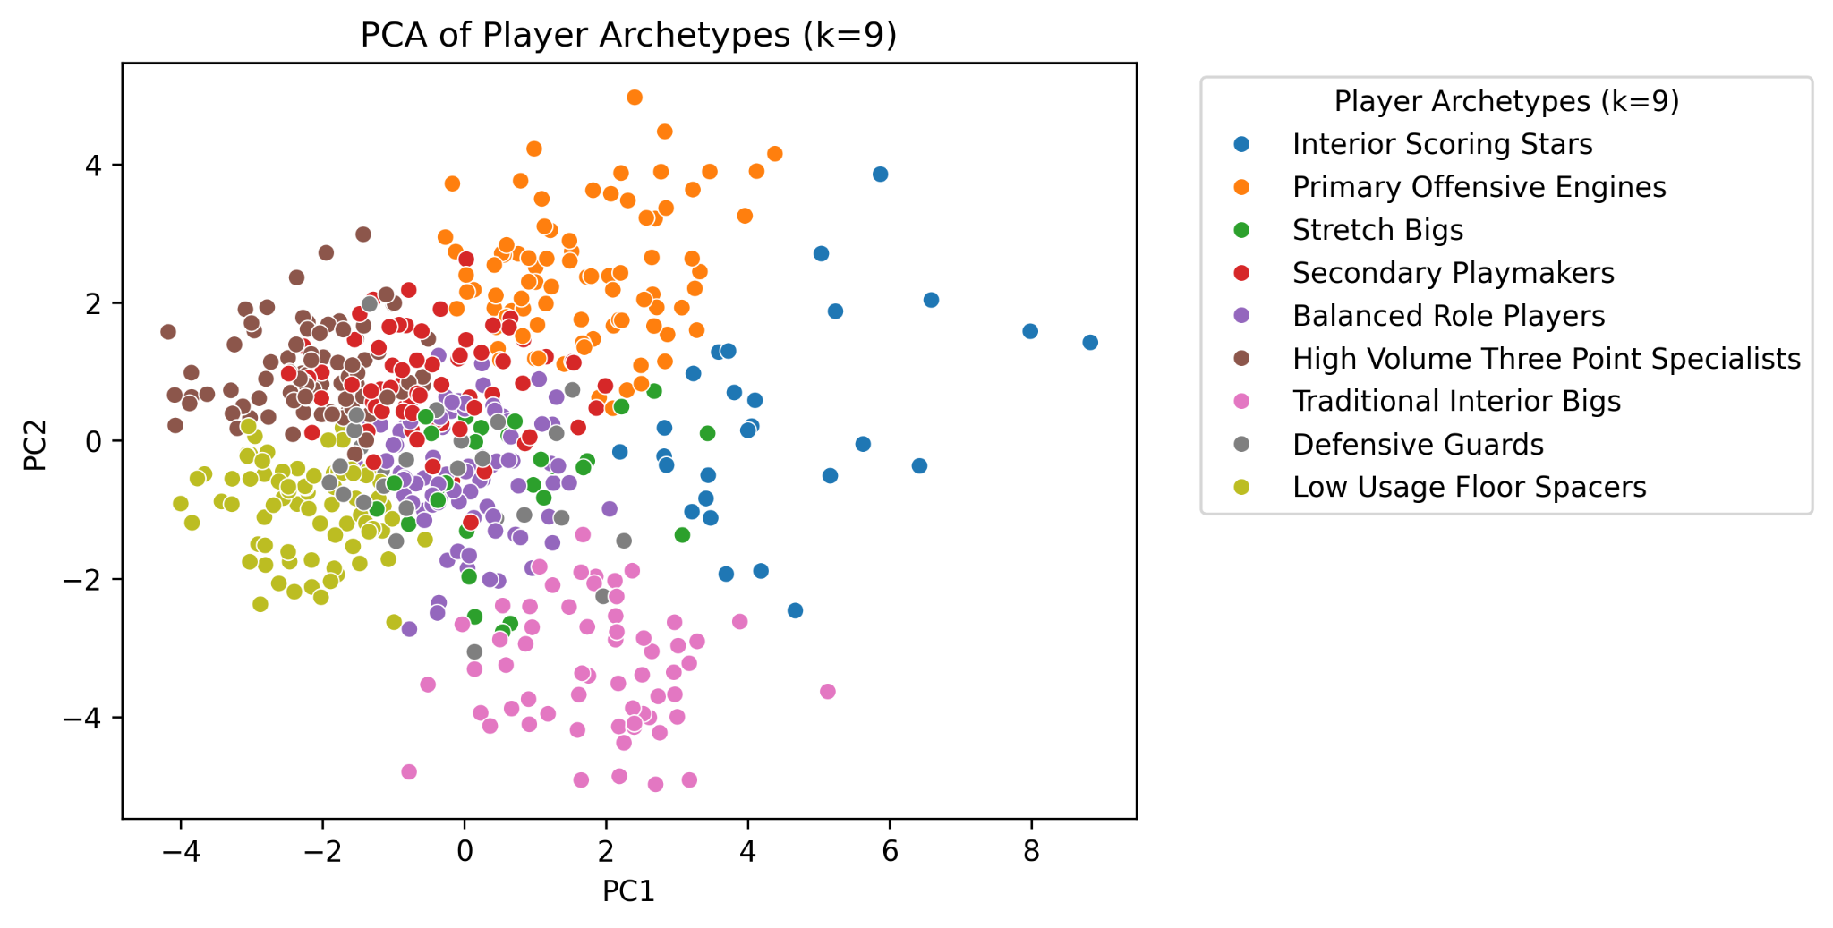
Clustering

Slide 18

Future Steps
Fit Models:
Linear Regression (baseline)
Random Forest Regressor
Predict PER and WS and Analyze Residuals:
Positive residual: player is overperforming
Negative residual: player is underperforming
Interpret Coefficients:
See what really leads to efficiency and winning

Slide 19
Thank You
Questions?

